Slide 1
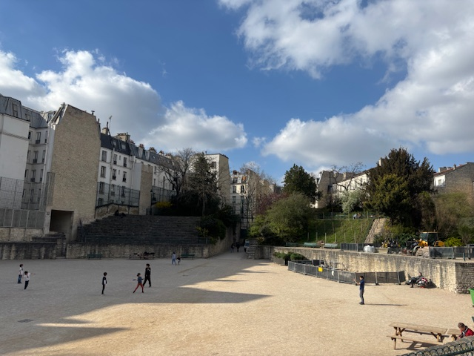
Tier one partner vist/review - paris – 24th to 27th March 2025
Paris Tier one partner review
BY emilie lauren howell
This is a roman amphitheatre in the later quarter! Who knew!

Slide 2
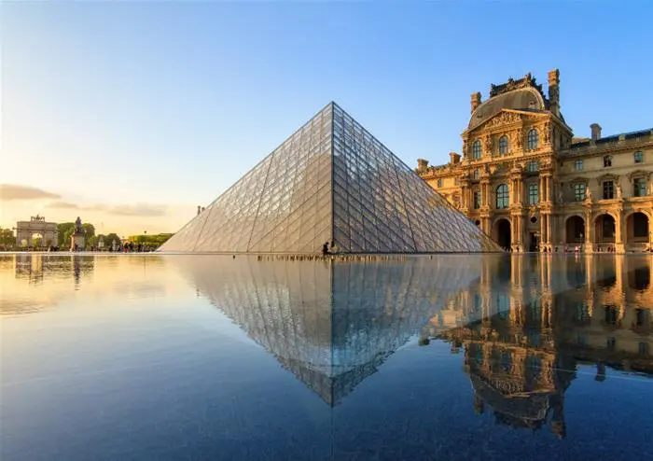
Itinerary
Dates: Monday 24th March to Thursday 27th Thursday.
Purpose: Viewing a selection of samples of our Paris tier one partners that we have historically booked with and new stock available to view.
Fam Trip: Joining Edyn Fam trip to stay at their new property, Le Jardin de Verre by Locke

Slide 3
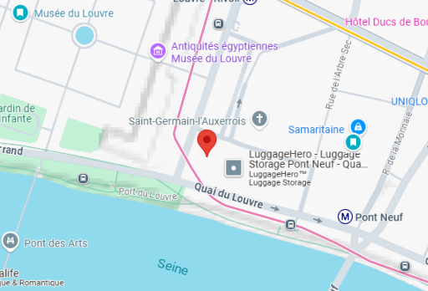
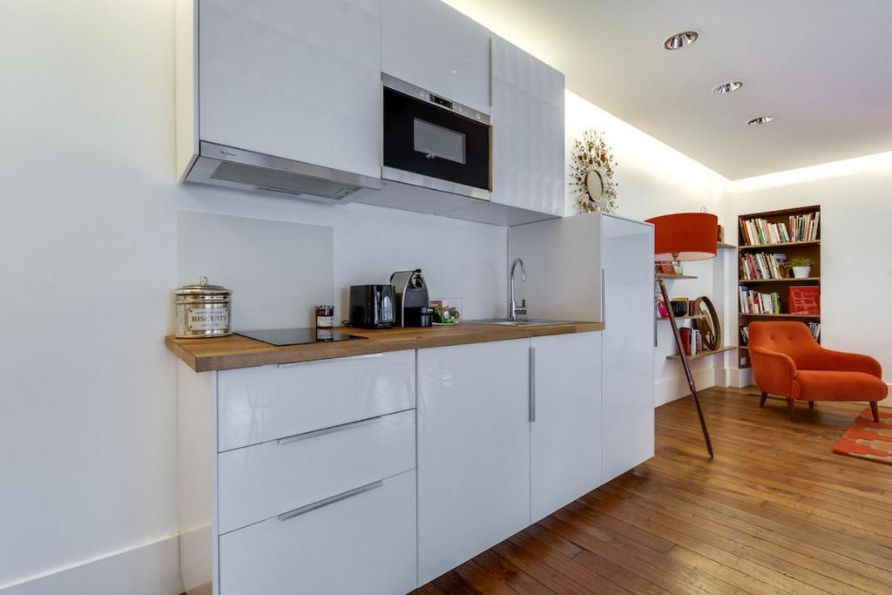
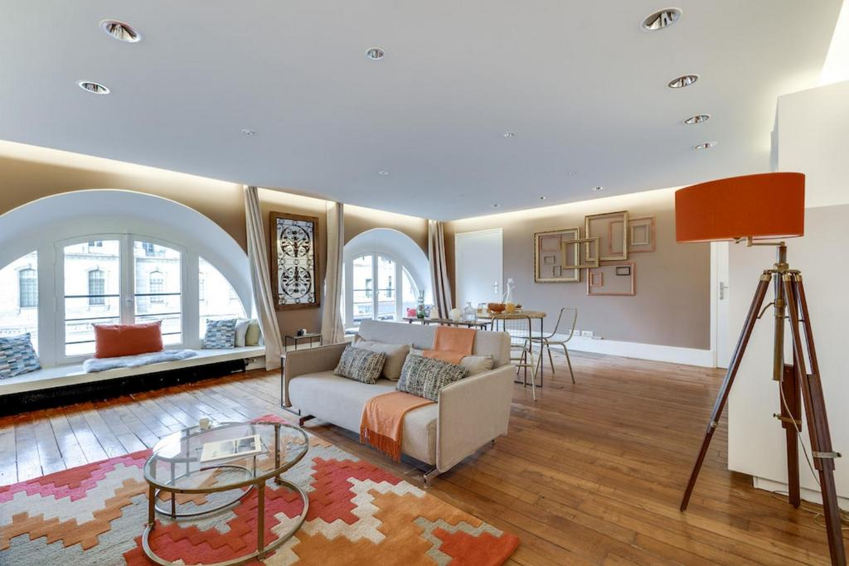
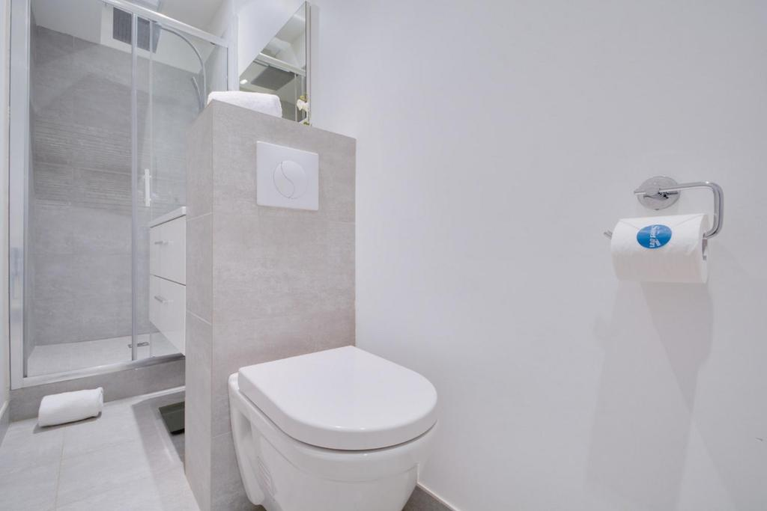
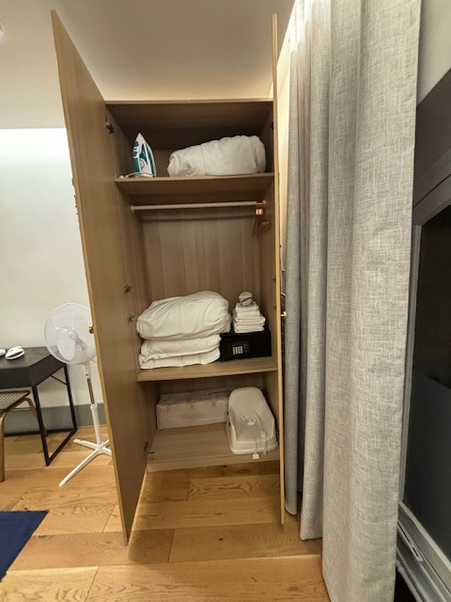
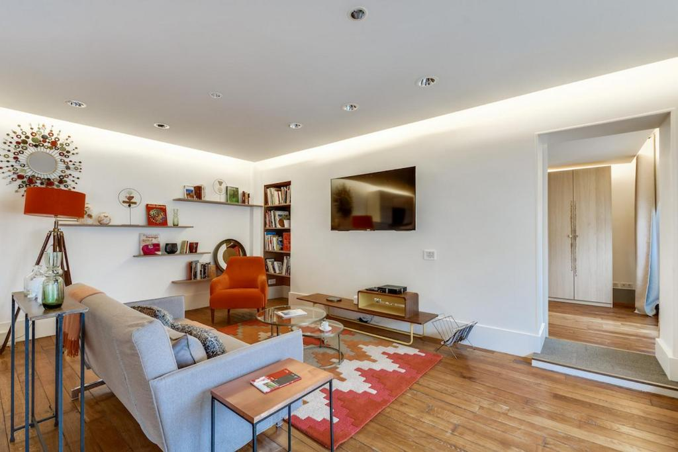
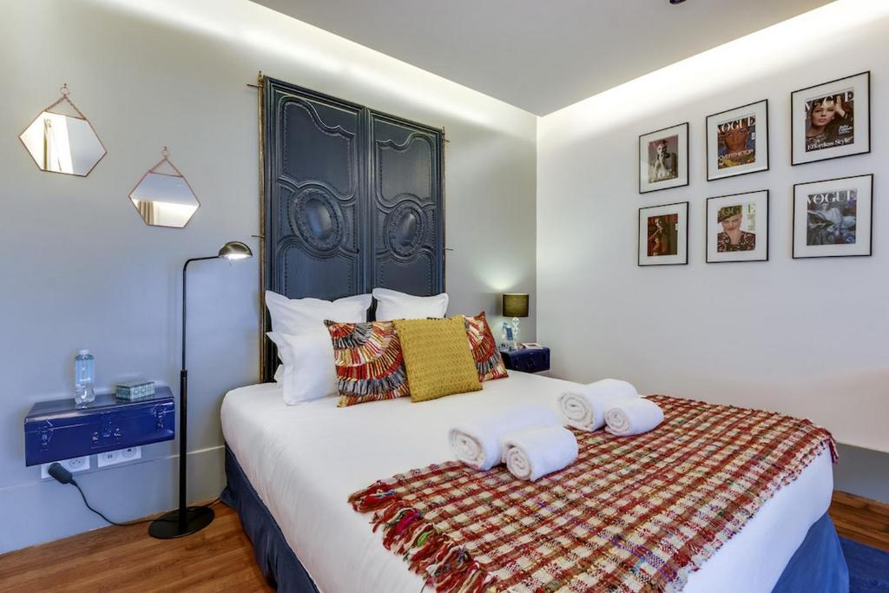
Sweett Stayed for 2 nights
Sweett - Amiral de Coligny
2 Rue de l'Amiral de Coligny, 75001 Paris, France
A large one-bedroom apartment in the 1st arrondissement with stunning views of the Louvre and the Eiffel Tower. The apartment was well-equipped for a comfortable long stay, featuring a comfortable bed, ample storage, a kitchen with a combi microwave, a 2-ring hob, and a large fitted fridge. The bathroom is small and narrow but offers high-quality amenities with pleasant fragrances. Upon arrival, Marie, the sales manager, welcomed me and provided thoughtful touches such as macarons, bottled water in the fridge, and coffee pods. The three windows in the apartment are old and not very good. The road right outside the apartment is rather noisy and loud at night.

Slide 4
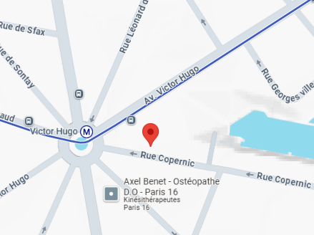
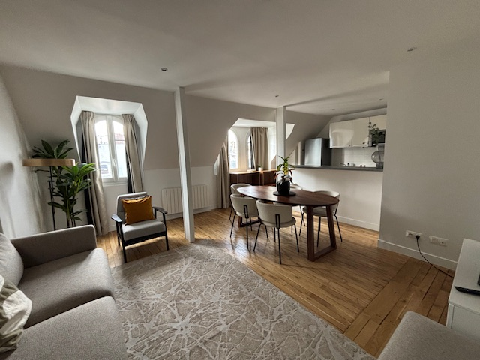
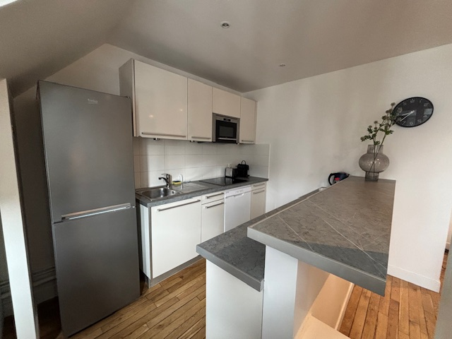
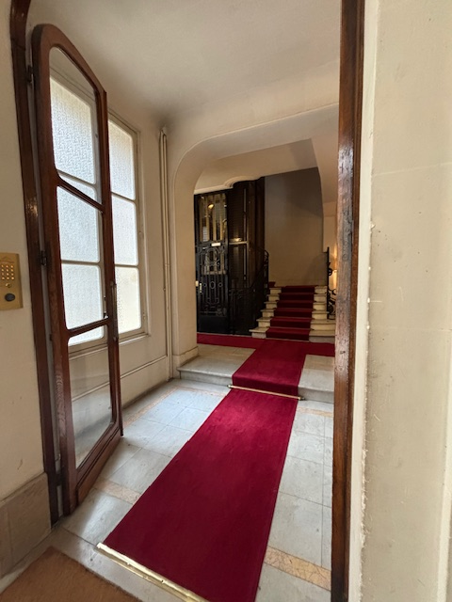
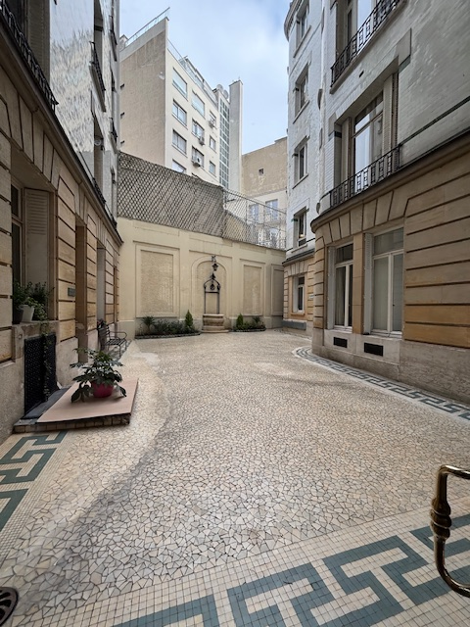
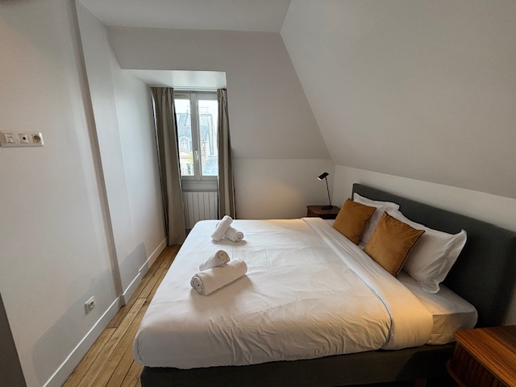
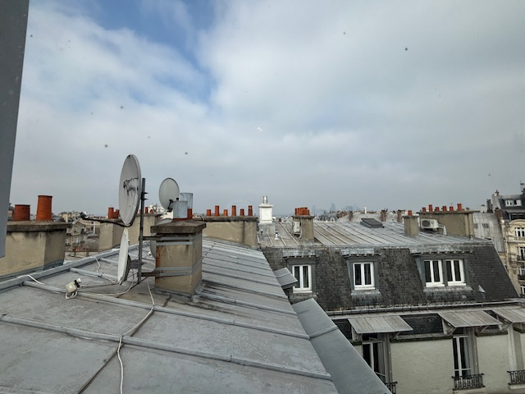
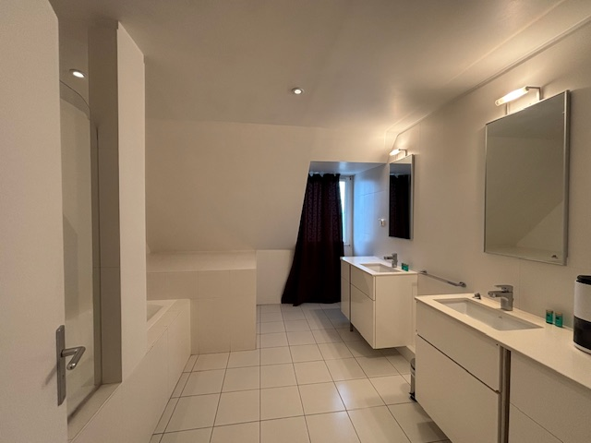
Oasis
Location: 50 Rue Copernic, 75016 Paris
Copernic - Loved this apartment – the common areas are really bright and smart and inviting. The area is really nice, One of Paris’s most prestigious neighbourhoods. Recently renovated building with smart and clean common areas, including mailboxes in the foyer. The apartment itself is very clean, bright, and welcoming, featuring large rooms well-equipped with all necessities. It offers a quiet living environment. Overall, a very impressive property.
PARIS TIER ONE PARTNER VIST/REVIEW
4

Slide 5
Oasis
Location
Loved this apartment – the common areas are really bright and smart and inviting. The area is really nice, One of Paris’s most prestigious neighbourhoods. Recently renovated building with smart and clean common areas, including mailboxes in the foyer. The apartment itself is very clean, bright, and welcoming, featuring large rooms well-equipped with all necessities. It offers a quiet living environment. Overall, a very impressive property.
PARIS TIER ONE PARTNER VIST/REVIEW
5

Slide 6
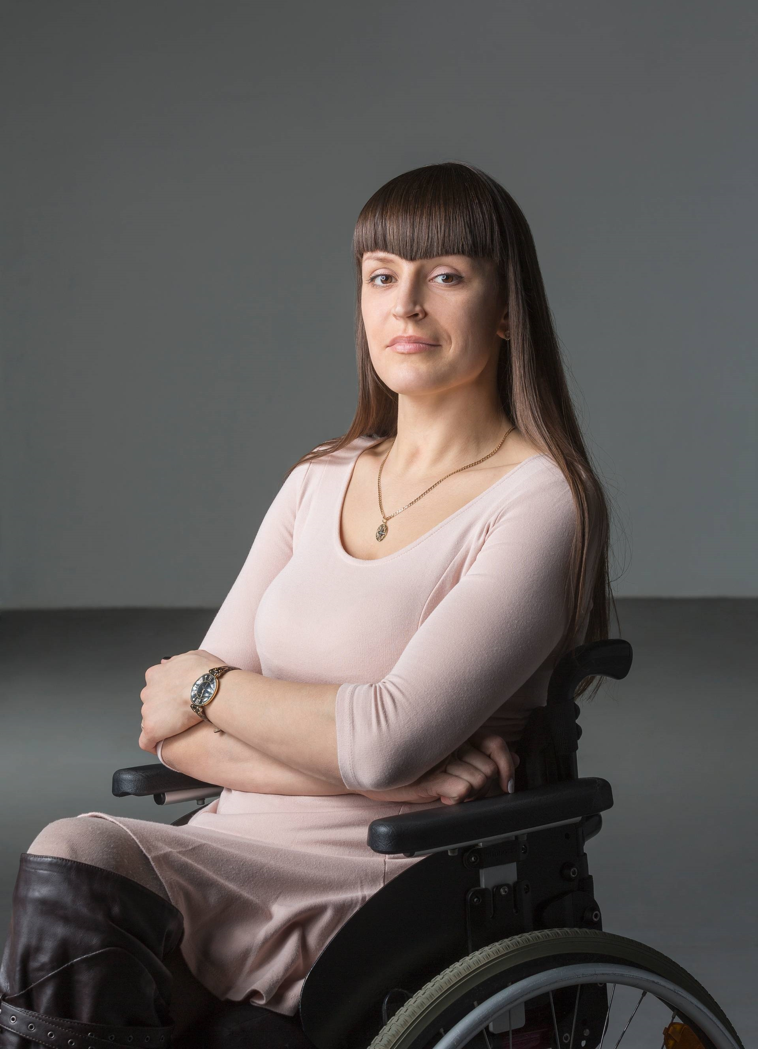


Three picture collage

Slide 7

  Second Property: Bright Étoile
    Location: 41 Avenue d'Iéna, 75116 Paris
    Description: A lovely apartment situated in a clean and welcoming building. Located on the 7th floor, the apartment is compact but very well maintained. It boasts a great location.
    Image Placeholders:
      Map pinpointing 41 Avenue d'Iéna, 75116 Paris
      Exterior and interior views of the Bright Étoile apartment
Transportation: Utilized the metro to meet with David from Oasis.​
Slide 6: Tuesday, March 25th - Afternoon
Meeting with Maria from Sweet Inn to view two apartments.
  Apartment 1: Details and images to be confirmed.​
  Apartment 2: Details and images to be confirmed.​Booking.com
Image Placeholders:
  Exterior and interior views of Apartment 1​
  Exterior and interior views of Apartment 2​
Slide 7: Wednesday, March 26th - Morning
Meeting with Olivia Paultre for apartment viewings:
  Unit 767
    Location: 77 Rue la Condamine, 75017 Paris
    Time: 10:15 AM
    Description: Details to be provided.
    Image Placeholders:
      Map pinpointing 77 Rue la Condamine, 75017 Paris
      Exterior and interior views of Unit 767
  Unit 839
    Location: 51 Rue de Saussure, 75017 Paris
    Time: 11:00 AM
    Description: Details to be provided.
    Image Placeholders:
      Map pinpointing 51 Rue de Saussure, 75017 Paris
      Exterior and interior views of Unit 839
Slide 8: Wednesday, March 26th - Afternoon
Transition to Le Jardin de Verre by Locke:
  Activities:
    Checked in and joined Richard Croker and Kim Winter for their familiarization trip.
    Lunch with the group.
    Property tour of Le Jardin de Verre by Locke.
    Walking wine tour.
    Dinner followed by drinks.
Image Placeholders:
  Exterior and interior views of Le Jardin de Verre by Locke​
  Group activities and dining experiences​Google+19Expedia+19Locke Living+19
Slide 9: Thursday, March 27th
Morning: Two hours of free time in Paris.​
Afternoon: Return flight to Bristol.​
Image Placeholder: Departure scenes or final views of Paris​
Slide 10: Summary and Impressions
Overall Experience:
  Explored a diverse range of apartments across various neighborhoods.​
  Gained valuable insights into Parisian living spaces and locales.​
  Engaged in enriching experiences with industry professionals.​
Image Placeholder: Collage of favorite apartments and memorable moments from the trip

Slide 8
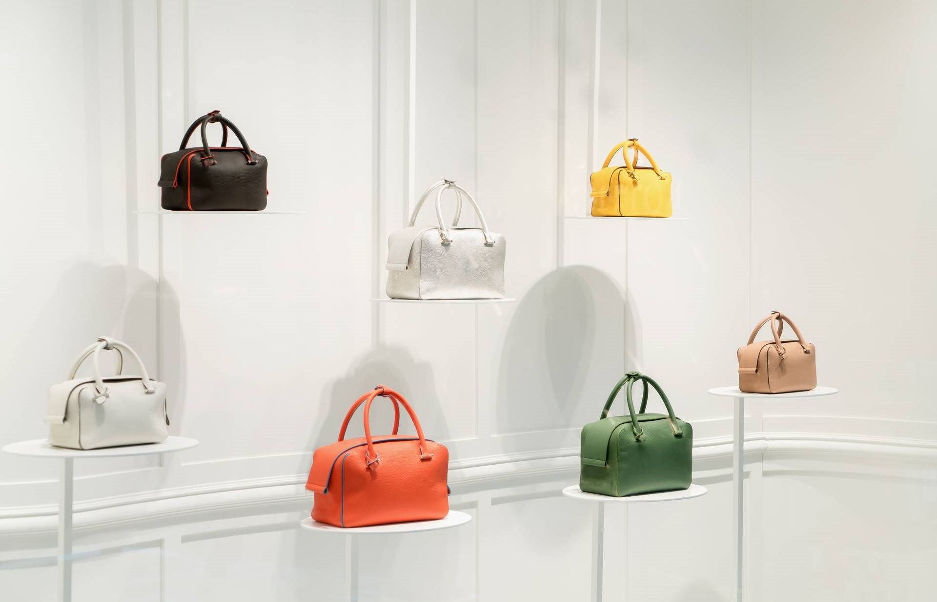



Four picture collage

Slide 9

EVENTS

Slide 10





Five picture collage

Slide 11
THANK YOU
sam@vanarsdel.com
(206) 555 - 4133
@vanarsdel
www.vanarsdel.com

